Slide 1
E-commerce Olist Store Analysis
Presented by Group – 1

Slide 2
Contents
01 . Introduction
02 . Overview
03 . KPI’S
04 . Insights & Proposed Improvements
05 . Conclusion

Slide 3
Introduction
Olist Is an e-commerce company based in Brazil.
As a data analyst we were tasked with exploring, Cleaning, and analyzing the Olist E-commerce Public Dataset.
The Dataset is designed to help analysts and researchers better understand the e-commerce landscape in Brazil and identify opportunities for growth and optimization.
To help olist gain better insights into its e-commerce platform and optimize available opportunities for growth,
We will perform an exploratory Data Analysis, and answer some business questions, thereby providing insights and recommendations.

Slide 4
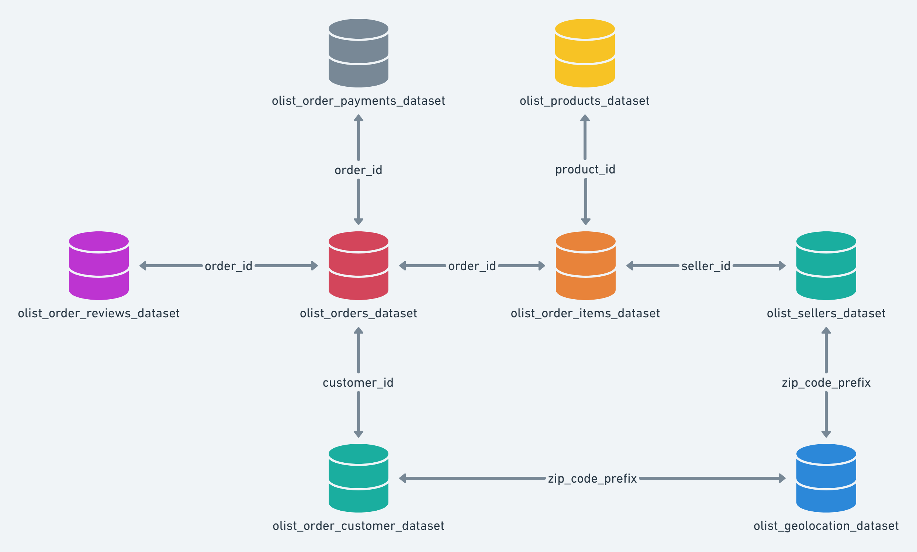
Joins of data sets

Slide 5
KPI’S
Weekday Vs Weekend (order_purchase_timestamp) Payment Statistics
Number of Orders with review score 5 and payment type as credit card.
Average number of days taken for order_delivered_customer_date for pet_shop
Average price and payment values from customers of sao paulo city
Relationship between shipping days (order_delivered_customer_date - order_purchase_timestamp) Vs review scores.

Slide 6
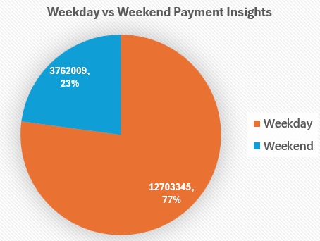
Weekday Vs Weekend (order_purchase_timestamp) Payment Statistics
KPI-1
The analysis of payment statistics based on weekday vs. weekend provides an understanding of the buying behavior of customers. This KPI answers questions like, which day of the week has the highest sales? How many customers prefer to pay through online modes? The analysis of this KPI can help Olist to improve their weekend sales and plan promotions accordingly.

Slide 7
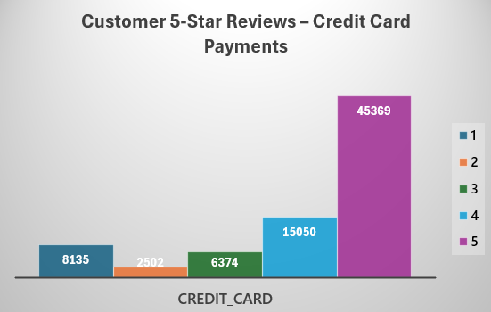
Number of Orders with review score 5 and payment type as credit card.
KPI-2
This KPI analyses the number of orders with a review score of 5 and payment type as credit card. This helps in understanding customer satisfaction levels and payment preferences. Olist can use this information to identify satisfied customers and encourage them to make repeat purchases

Slide 8
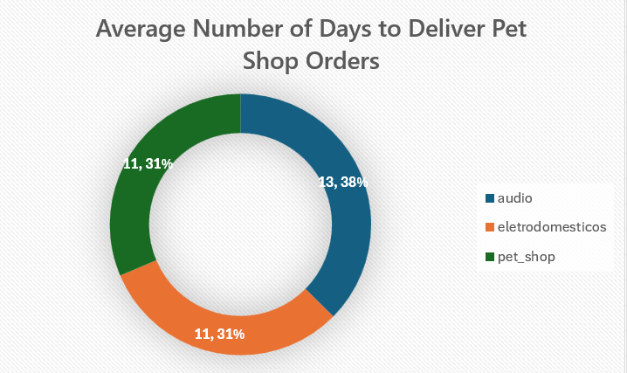
Average number of days taken for order_delivered_customer_date for pet_shop
KPI-3
This KPI analyzes the average number of days taken for order_delivered_customer_date for pet_shop. It helps Olist in identifying areas where they can improve their delivery time and maintain customer satisfaction.

Slide 9
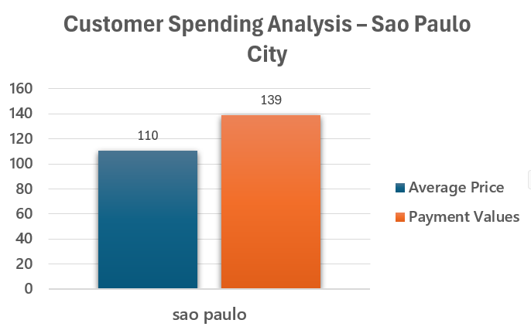
Average price and payment values from customers of sao paulo city
KPI-4
The analysis of average price and payment values from customers of Sao Paulo city helps in understanding the spending patterns of customers in this region. It also helps Olist in identifying high-value customers and creating targeted marketing campaigns.

Slide 10
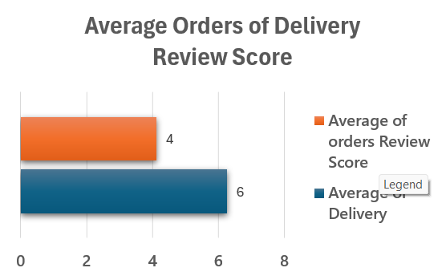
Relationship between shipping days (order_delivered_customer_date - order_purchase_timestamp) Vs review scores.
KPI-5
This KPI analyzes the relationship between shipping days and review scores. It helps in understanding the impact of delivery time on customer satisfaction levels. Olist can use this information to optimize their logistics and improve their delivery time.

Slide 11
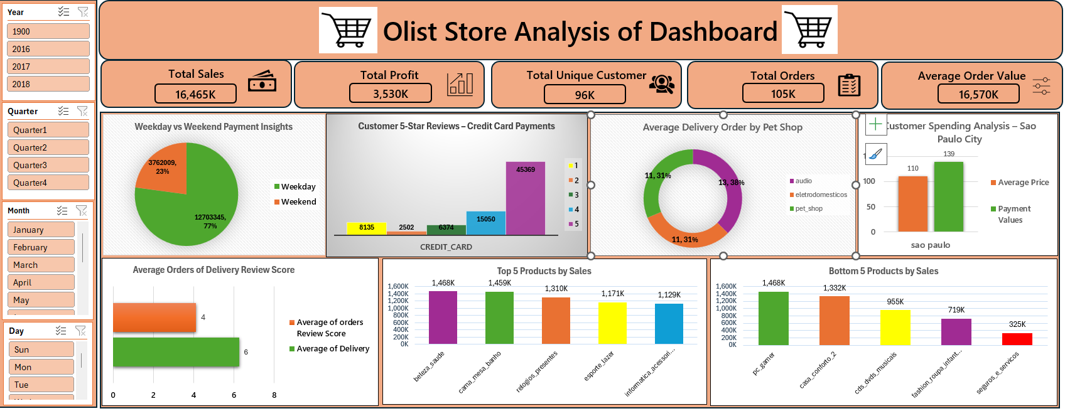
Excel Dashboard

Slide 12
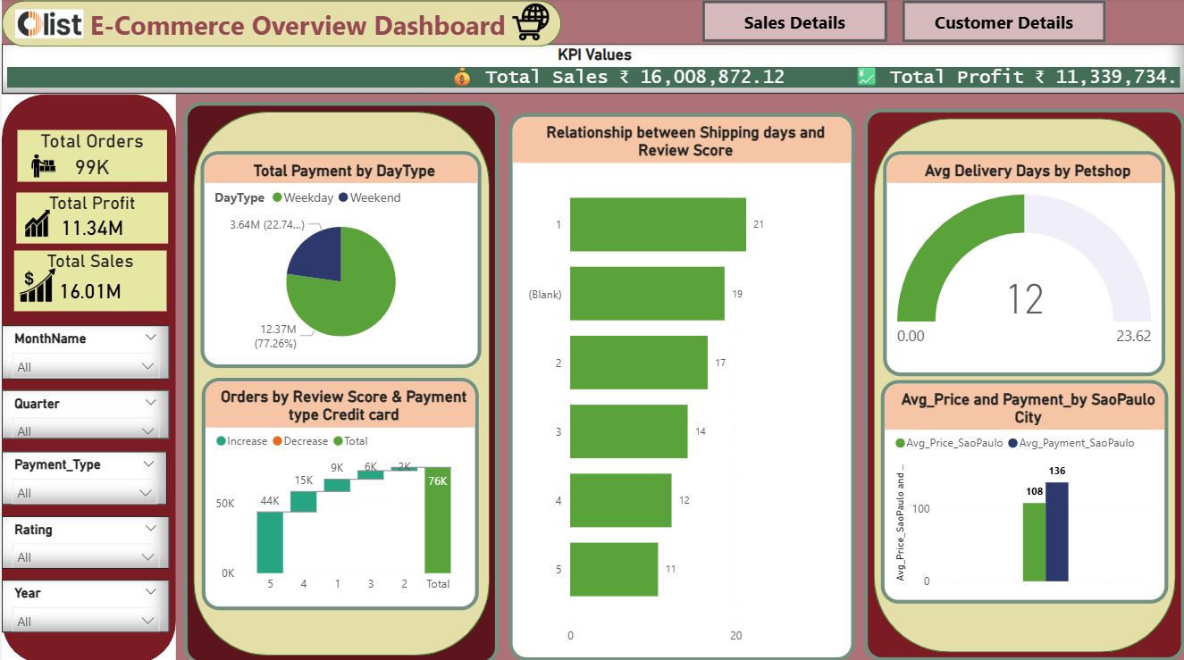
Power BI Dashboard

Slide 13
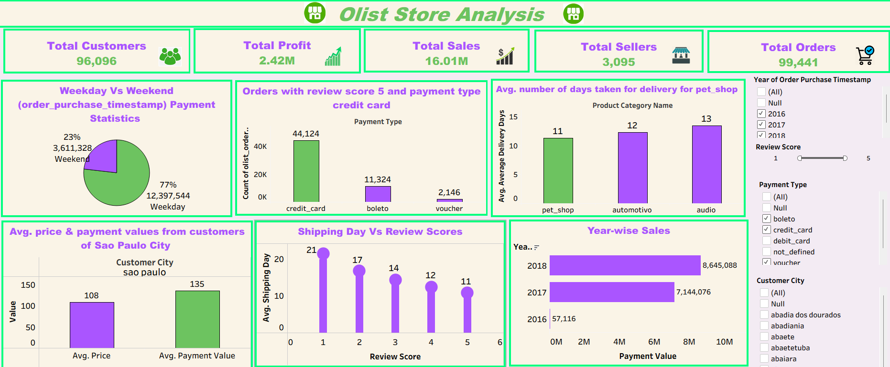
Tableau Dashboard

Slide 14
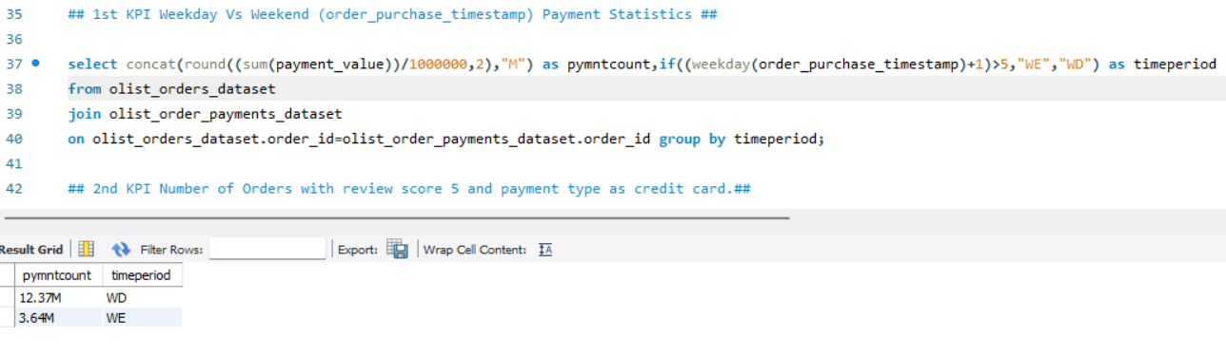
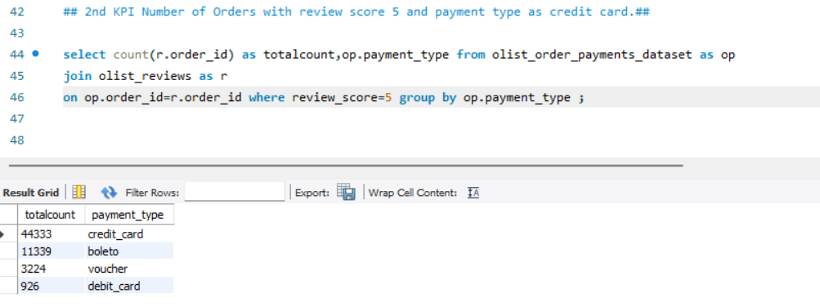
MySQL KPI’s queries

Slide 15
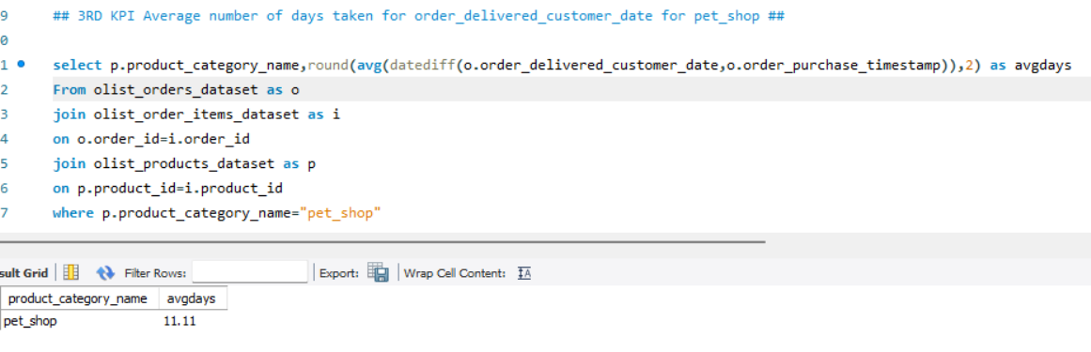
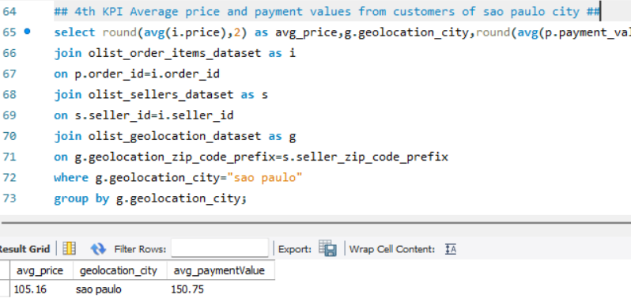

Slide 16
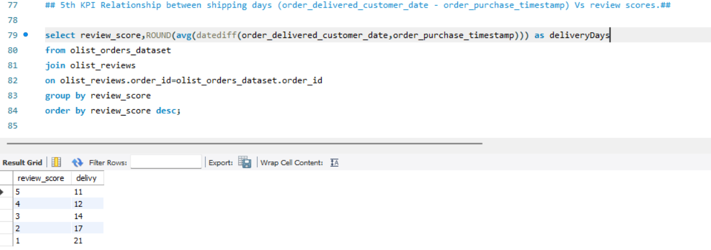

Slide 17
Insight
Based on the data, Olist E-commerce processed approximately 99,442 orders, out of which around 89,940 were successfully delivered — indicating a 90% delivery success rate. The platform’s average product rating stands at 4.09 stars, with individual product categories ranging from 2.5 to 4.68 stars. Interestingly, one-star reviews rank third in frequency, suggesting potential issues related to product quality in certain categories. Delivery performance may also be influencing customer feedback, highlighting an opportunity to enhance logistics efficiency.
The insights from this analysis can guide key business decisions — such as identifying high-demand products, improving product and service quality, and optimizing marketing strategies in regions with strong sales performance. Moreover, the findings provide a clearer understanding of customer behavior and purchasing trends, which can be leveraged to shape future business strategies.

Slide 18
Proposed Improvements
Regularly monitor and analyze customer reviews to gain insights in product quality and identify areas for improvement. Dashboards can be used to identify patterns in customer reviews. This will provide a data-driven approach to enhance customer experience. Investigate delivery delays and undelivered orders. Analyzing geographic locations could bring insights about certain challenges with demographics, accessibility, and possible route optimization. Tracking fleet performance with the use of telematics can help identify issues before they become a problem. Providing a proper shipment tracking system aids in having clear and concise communication between customers, sellers and couriers. Regular updates can set proper expectations among customers and specific delivery instructions of customers can be properly accommodated. By establishing trust and communication, both parties can work together to resolve any issues that may arise.

Slide 19
Summary
Consistent monitoring of customer feedback, real-time evaluation of delivery operations, and an efficient shipment tracking and communication system can significantly enhance Olist’s logistics performance and ensure a high level of customer satisfaction.

Slide 20
Conclusion
The Olist Store Analysis project provides valuable insights into customer behavior and payment statistics. The analysis of these KPIs helps Olist in identifying areas of improvement and creating targeted marketing campaigns. As a data analyst, I have used Excel and Power BI to clean and manipulate the dataset and create meaningful visualizations. This project serves as a great example of how data analysis can help businesses make informed decisions.

